Slide 1
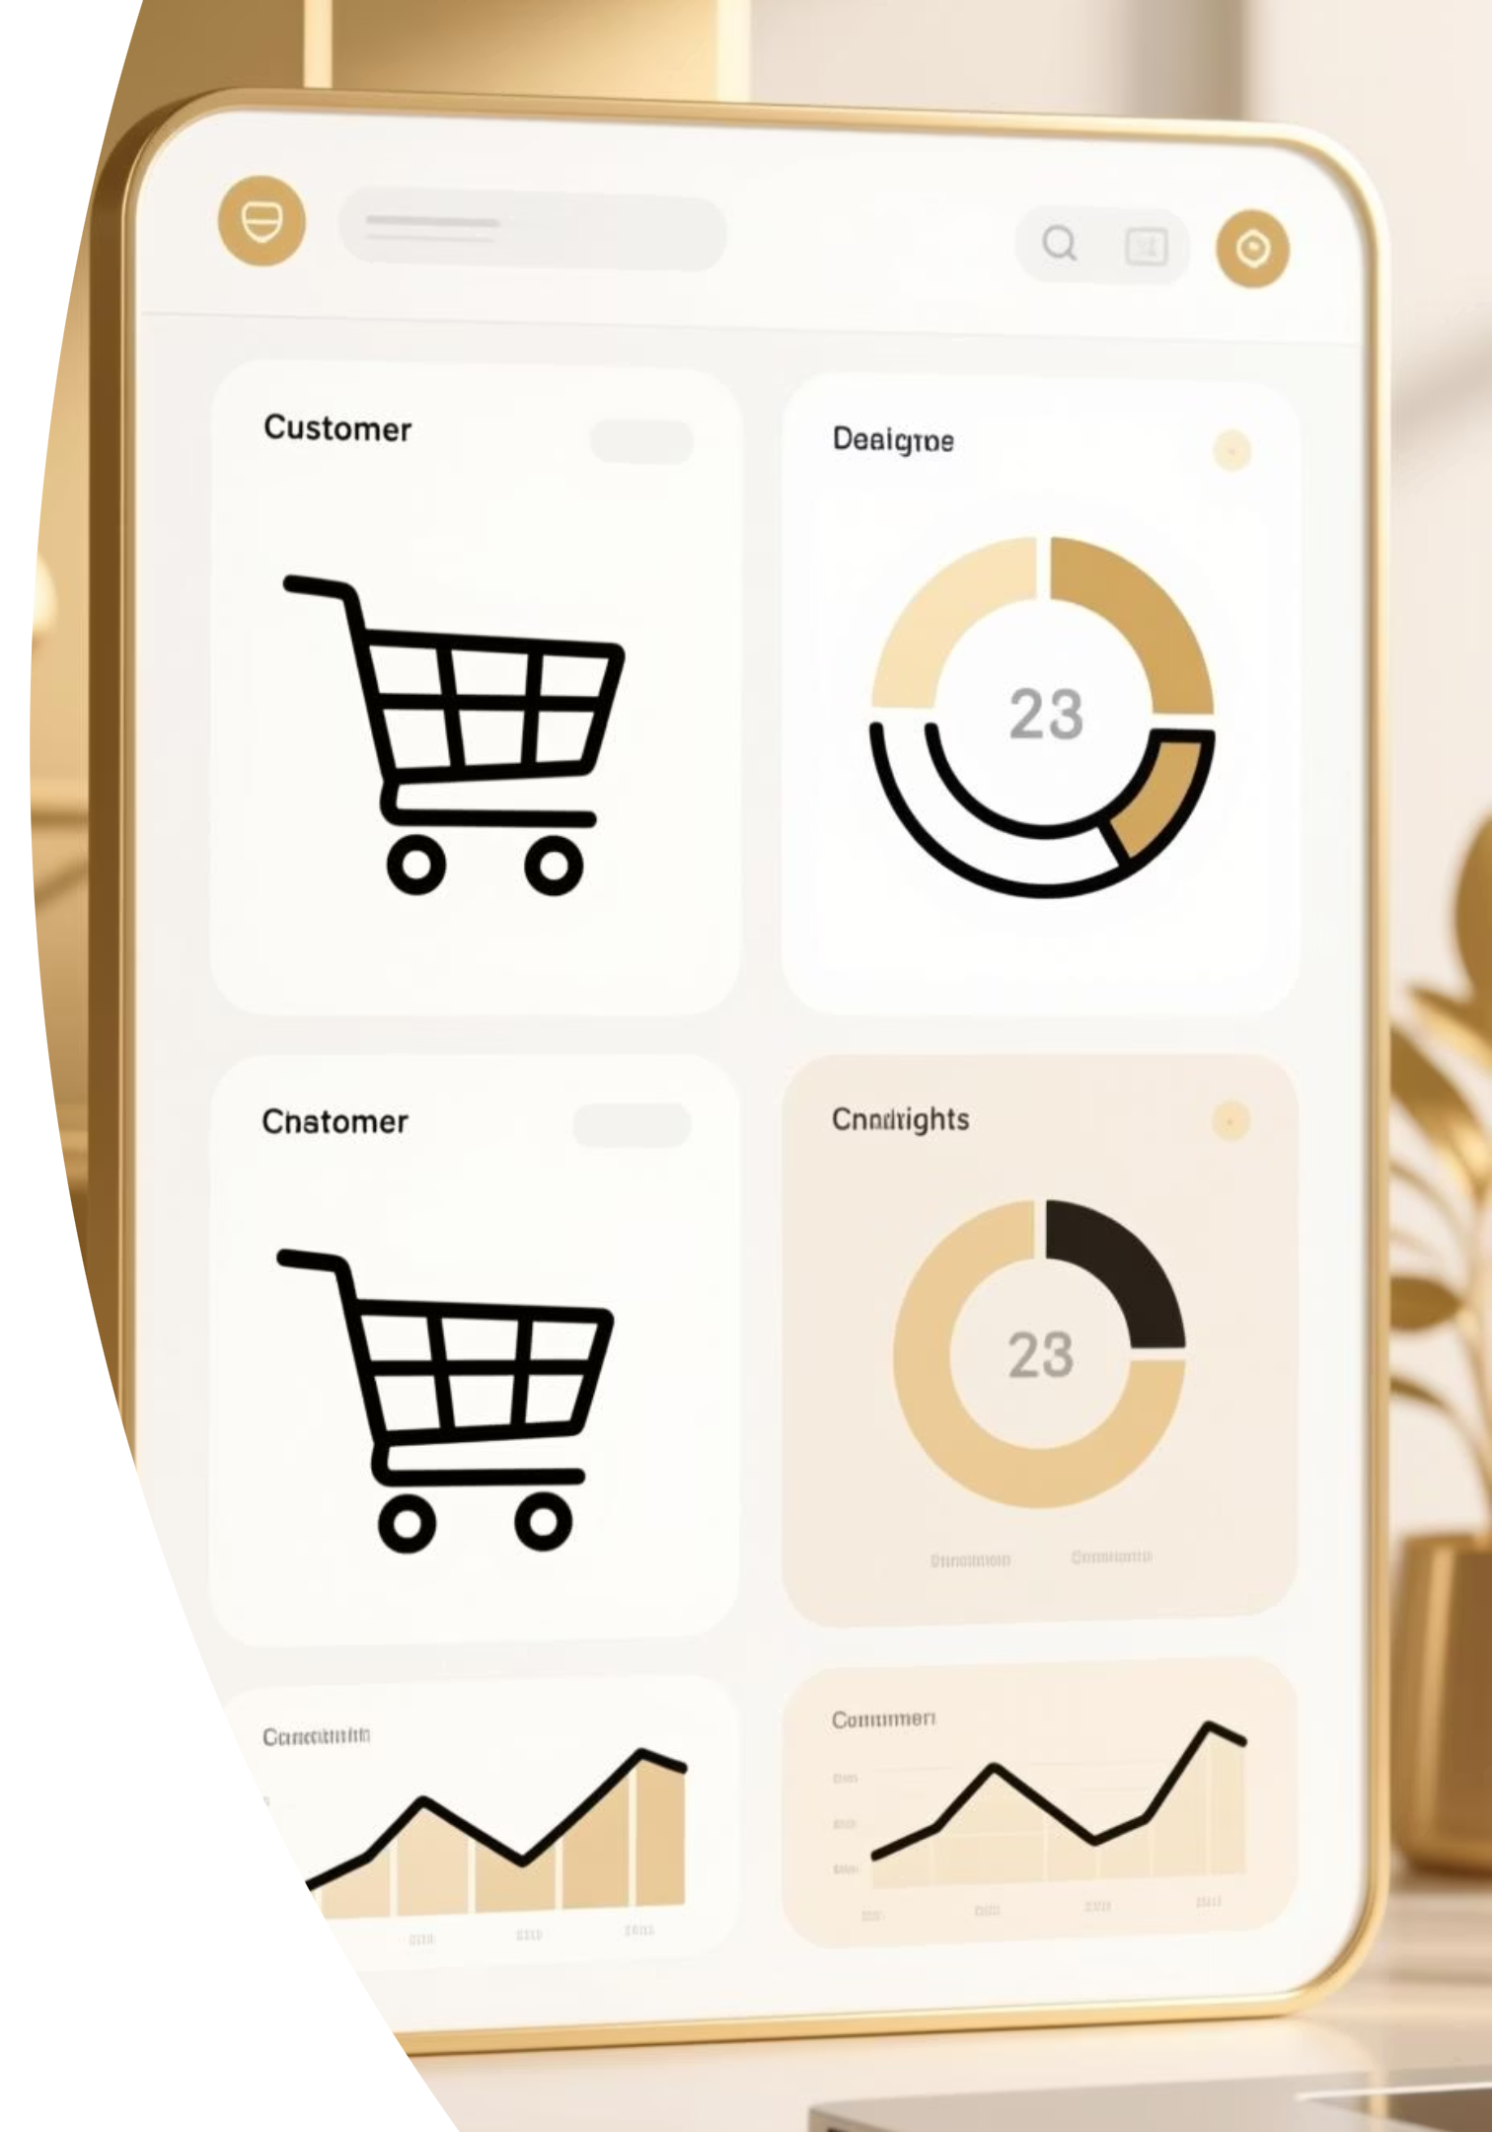
Customer Purchase Insights
Analyzing shopping behaviour from 3,900 transactions to uncover strategic opportunities in spending patterns, customer segments, and product preferences.

Slide 2
Dataset Overview
Scale & Structure
01
Our analysis covers 3,900 purchases across 18 data columns, providing comprehensive insights into customer behavior and transaction patterns.
Demographics
Age, Gender, Location, Subscription Status
The dataset includes customer demographics, purchase details, and shopping behavior metrics, with only 37 missing values in the Review Rating column.
02
Purchase Details
Item, Category, Amount, Season, Size, Color
03
Shopping Behavior
Discounts, Promo Codes, Purchase History, Ratings, Shipping

Slide 3





Data Preparation & Engineering
We performed comprehensive data cleaning and feature engineering in Python to ensure analysis-ready data quality.
Data Loading
Data Cleaning
Imported dataset using pandas and explored structure with df.info() and .describe()
Imputed missing Review Ratings using median values per product category
Feature Engineering
Database Integration
Created age_group bins and purchase_frequency_days columns for deeper analysis
Connected to MySQL Workbench and loaded cleaned data for SQL analysis

Slide 4

Key Business Insights
Revenue & Customer Segmentation Analysis
Gender Revenue Split
Customer Segments
Male customers generate $1,241,905 in revenue compared to female customers at $1,236,645 — nearly equal distribution.
Loyal customers (1,300) drive the most value, followed by Returning (1,300) and New customers (1,300) — balanced distribution.
Subscription Impact
Subscribers spend $59.87 on average vs. $59.76 for non-subscribers, but represent only 27% of the customer base.

Slide 5
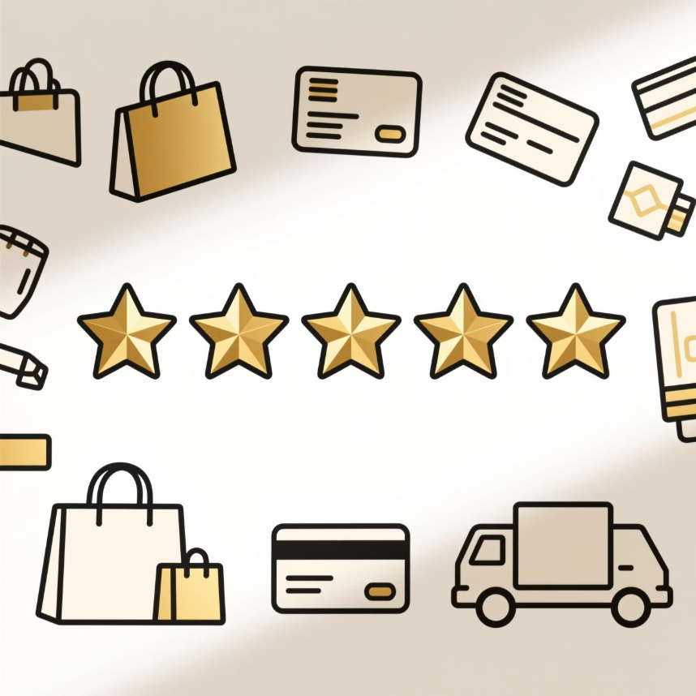
Product Performance Analysis
4.0
Top-Rated Products
Five products achieved the highest average review ratings, led by Dress and Blouse with perfect scores, followed by Jewelry, Handbag, and Shirt.
Average Rating
Top products maintain excellent customer satisfaction
Discount-Dependent Products
60%
Five items show the highest percentage of discounted purchases: Coat, Dress, Handbag, Hoodie, and Jacket — indicating price sensitivity in these categories.
Discount Rate
For most discount-dependent items
Category Leaders
Top 3 products per category reveal strong preferences: Blouse, Jewelry, and Dress in Clothing; Backpack, Handbag, and Belt in Accessories.

Slide 6
Shipping & Spending Patterns
Express Shipping
Standard Shipping
High-Value Discount Users
Customers choosing Express shipping spend an average of $59.84 per purchase, showing willingness to pay for speed.
Standard shipping customers spend $59.79 on average — minimal difference suggests shipping choice doesn't significantly impact order value.
Many customers who use discounts still spend above the average purchase amount, indicating strategic discount use rather than budget constraints.

Slide 7
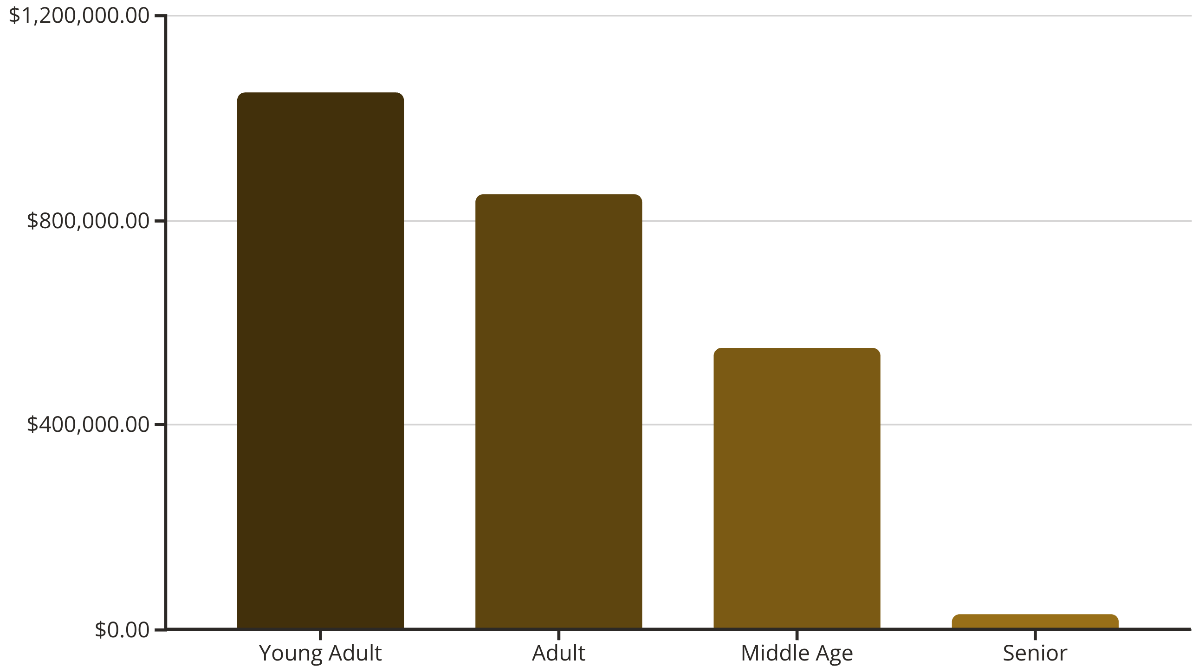
Age Group Revenue Contribution
Revenue distribution across age segments reveals the Young Adult group as the dominant force in purchasing power.
Young Adults drive the highest revenue and sales volume, making them the priority segment for targeted marketing campaigns and product development.

Slide 8
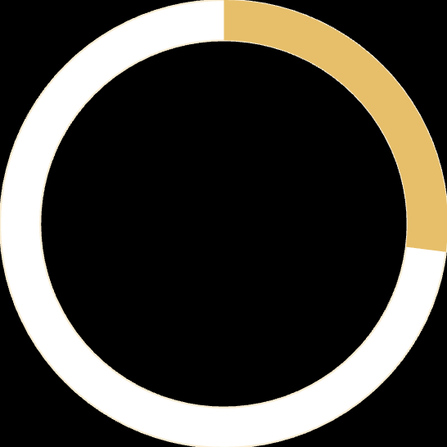
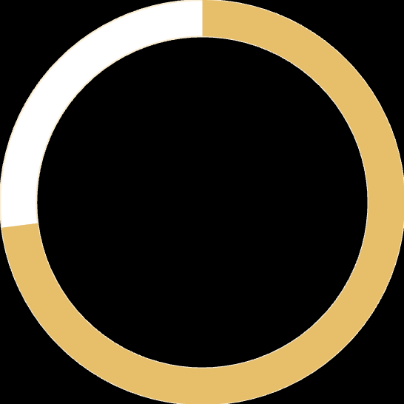
Subscription Behavior Insights
Repeat Buyers & Loyalty
Customers with more than 5 purchases show higher subscription rates, indicating that purchase frequency correlates with subscription likelihood.
27%
This presents a significant opportunity to convert the 73% non-subscribed customer base through targeted loyalty programs and exclusive benefits.
Subscribed
Current subscription rate
73%
Not Subscribed
Untapped opportunity

Slide 9
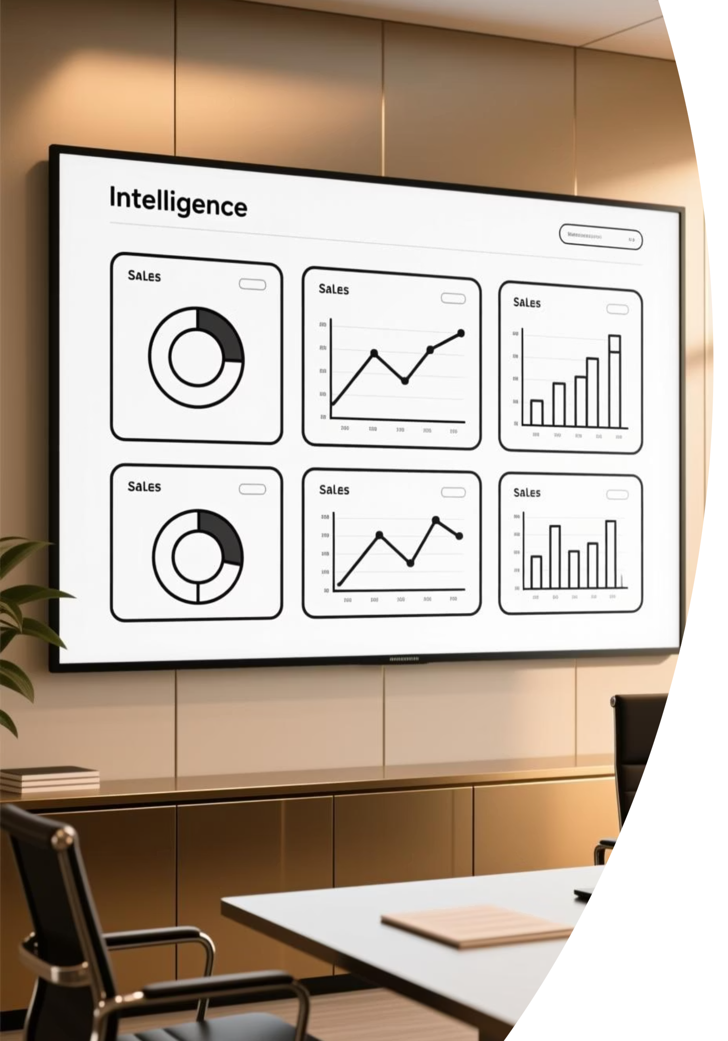
Interactive Dashboard
We built a comprehensive Power BI dashboard to visualize key metrics and enable real-time business intelligence.
Revenue Tracking
Customer Insights
Real-time monitoring of sales performance across segments and categories
Interactive filters for age groups, subscription status, and purchase behavior
Product Analytics
Category performance, ratings, and discount impact visualization

Slide 10





Strategic Recommendations
Five data-backed strategies to increase sales and customer engagement:
Strengthen Loyalty Programs
Focus on Young Adults
Expand Top Categories
Introduce rewards and exclusive discounts for subscribers. Offer "first-month free" trials and personalized recommendations to convert the 73% non-subscribed base.
Prioritize digital marketing on Instagram and YouTube. Launch trendy product lines and optimize campaigns for the highest-revenue age segment.
Introduce new styles and seasonal collections in Clothing & Accessories. Run category-specific discounts to drive 20-30% incremental sales.
Optimize Checkout
Promote Fast Shipping
Simplify payment flow for popular methods. Offer one-click checkout and "Buy Now, Pay Later" options to reduce cart abandonment.
Offer free express delivery for orders above threshold. Highlight delivery times prominently to increase repeat purchases and customer trust.

